Slide 1
3D Integrated Circuits
Notes:
We can study this problem from a lot of point of views. Today, I’ll choose the economic angle.

Slide 2


Slide 3
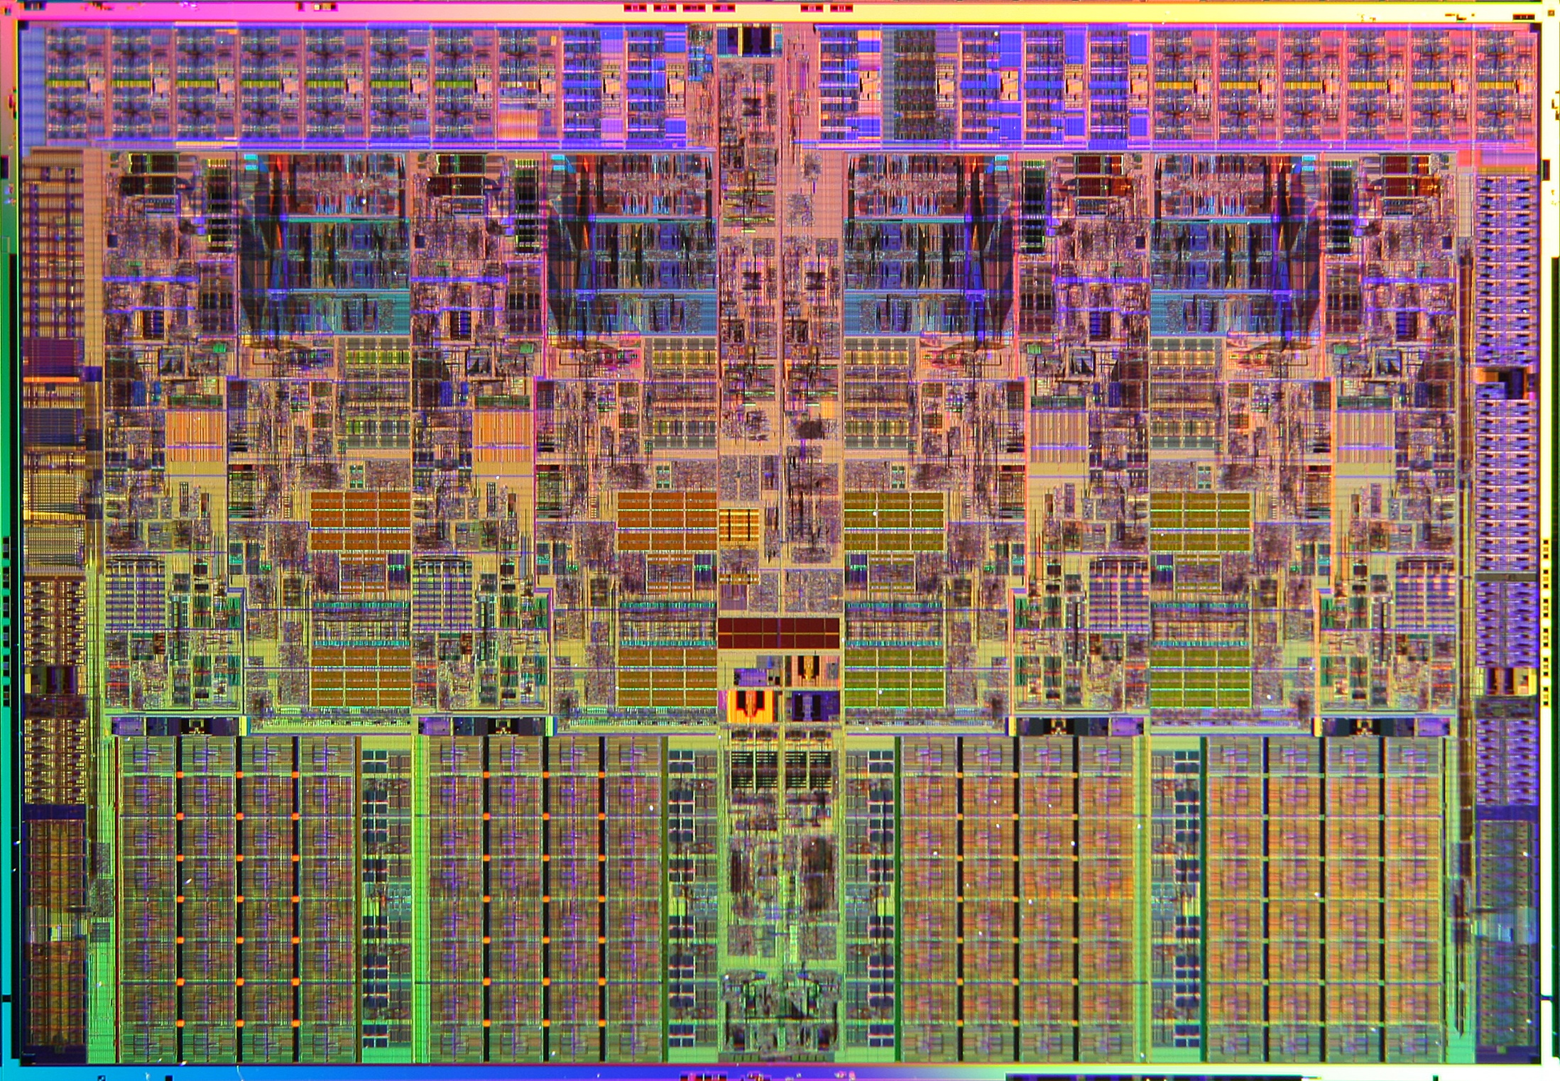

Slide 4
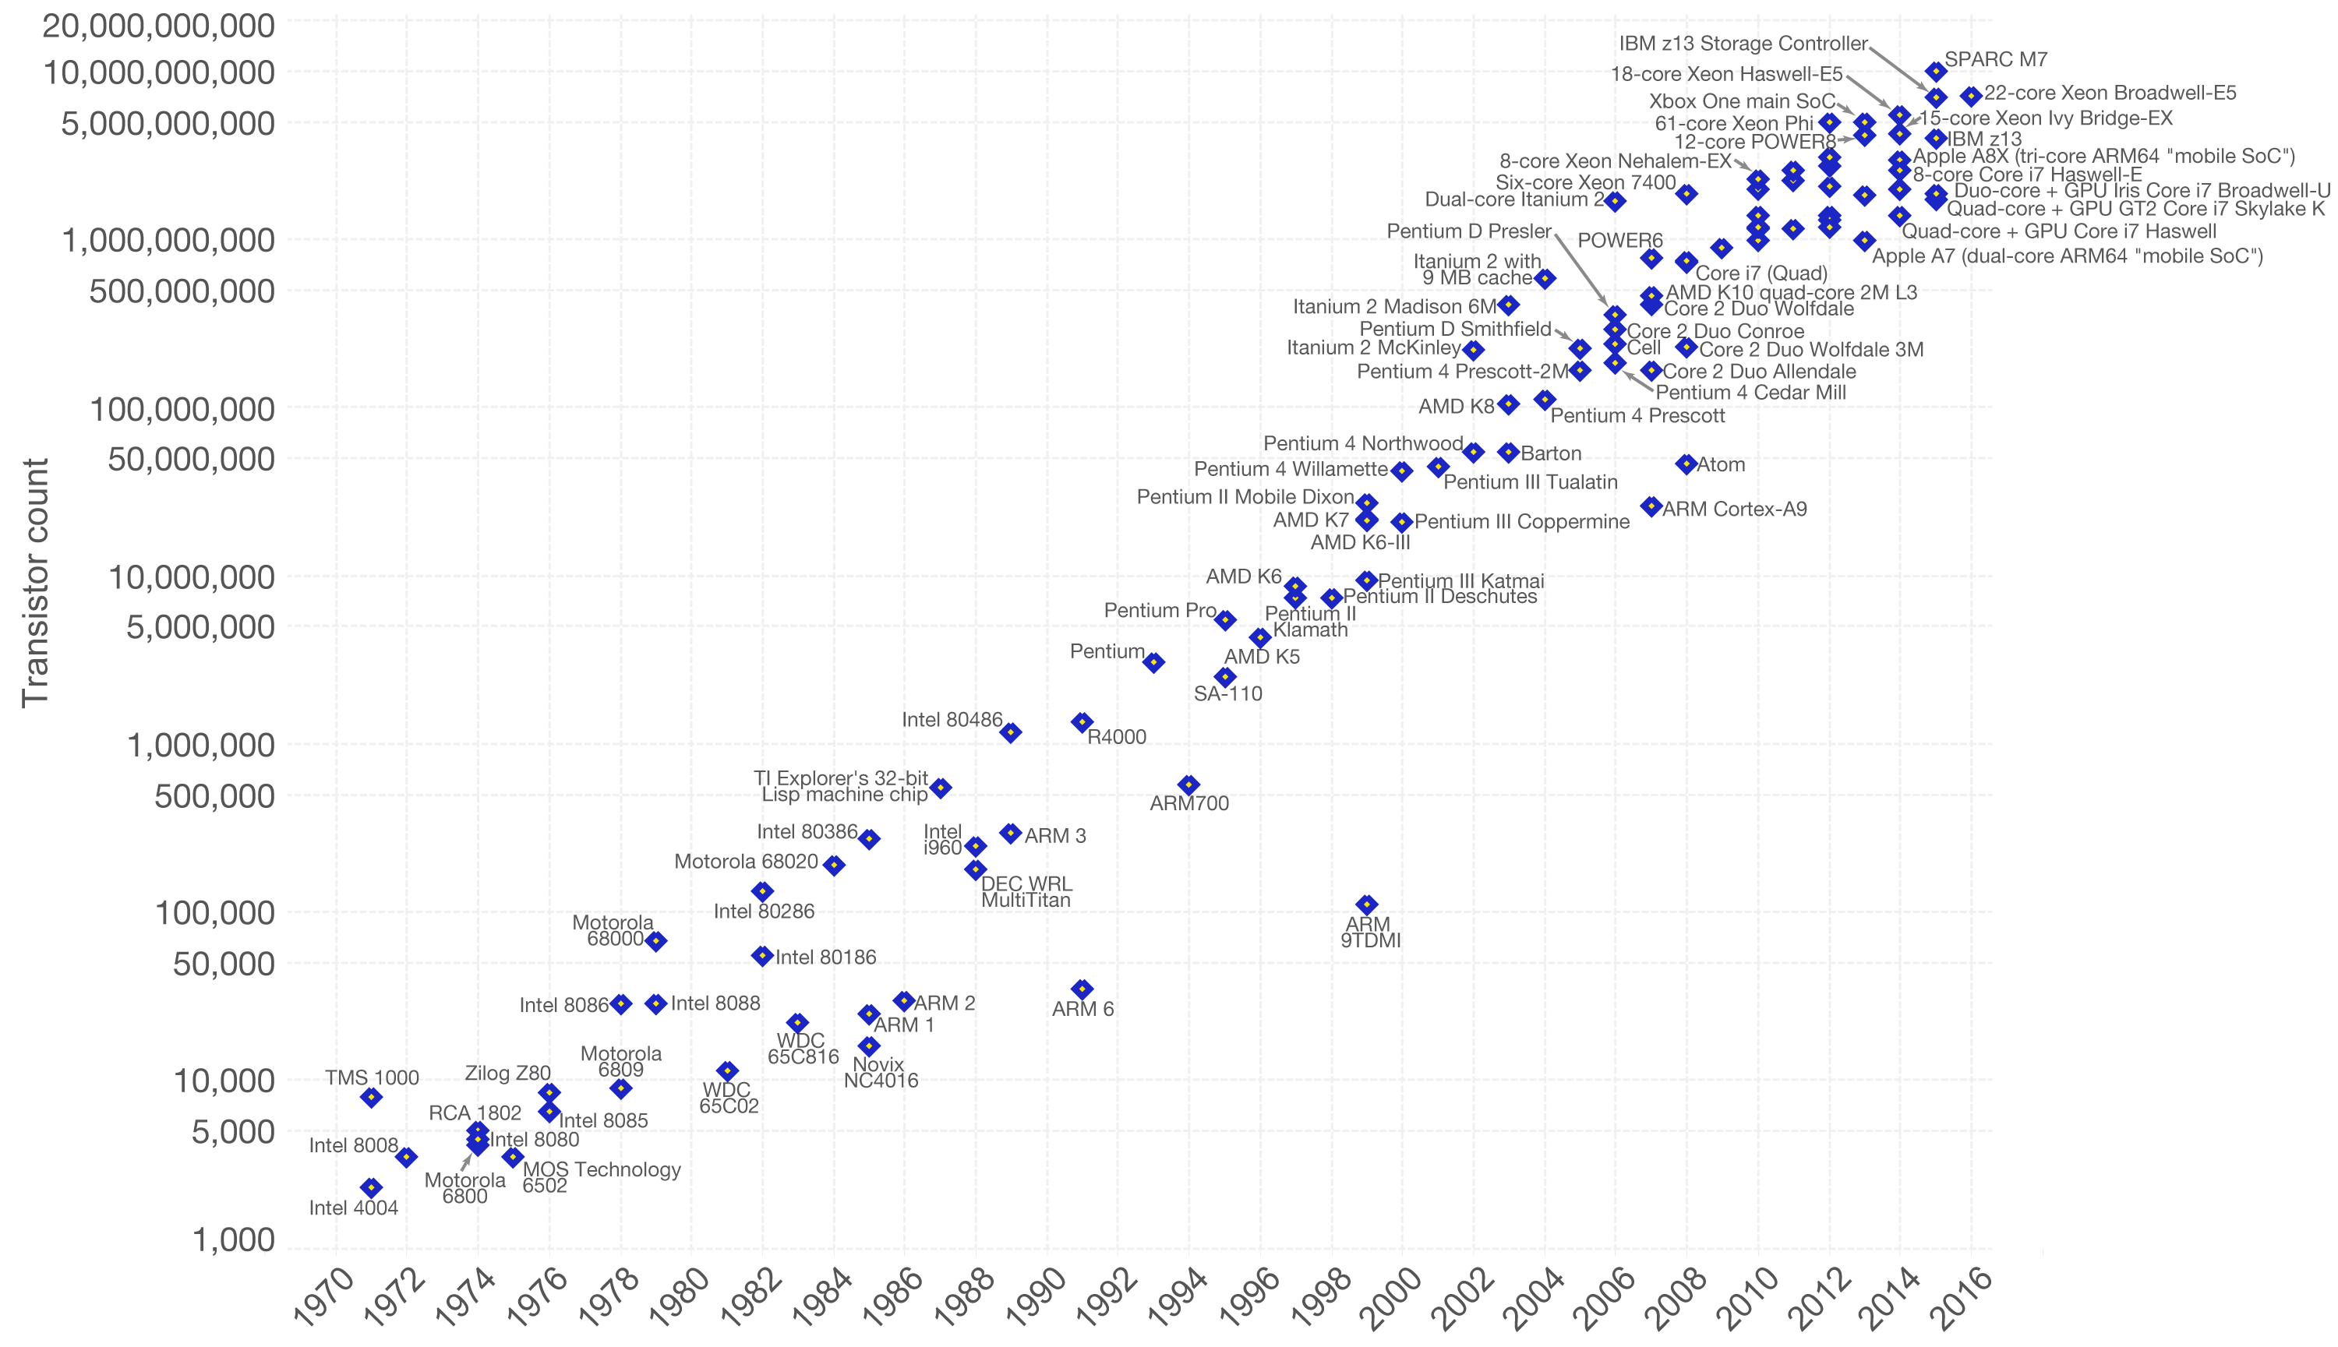
Moore’s Law
Notes:
Moore's law is the observation that the number of transistors in a dense integrated circuit doubles about every 18 months.

Slide 5




Do you know them?
TSMC
Samsung
Intel
Global Foundries

Slide 6
Do you know them?

Slide 7
Together, they dominate...
Over 73% of the market.

Slide 8
Market share percentage
TSMC

Slide 9
Together, they make...
Over $46 billions in revenue.

Slide 10
Together, they lead...
The technology race
and state-of-the-art techniques.
Notes:
They lead the technology race

Slide 11
TOP 4 Foundries
Market domination
Stellar revenue
Technology leaders
Notes:
And even though they are so far ahead, it’s getting to freaking expensive.

Slide 12
Rock’s Law is killing the market
Double the manufacturing cost every two years.
Past $15 billions for the previous node.

Slide 13
GF drops out
“GlobalFoundries is putting its 7nm finFET program on hold indefinitely and has dropped plans to pursue technology nodes beyond 7nm.”
Notes:
This had the effect of a bomb.

Slide 14
Extend Moore’s Law
New transistors topologies
New materials
Heterogeneous integration
3D integration

Slide 15
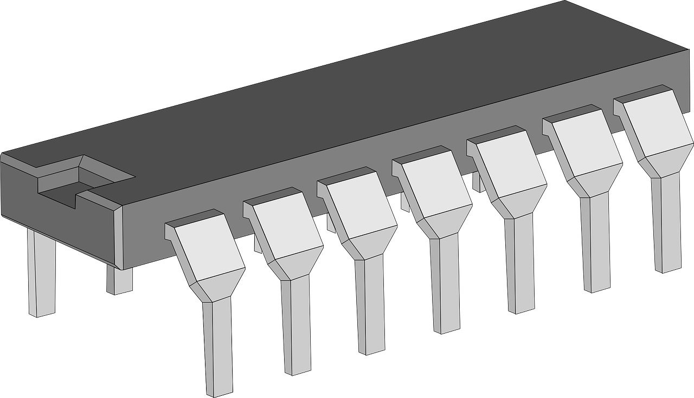
What is a 3D IC?

Slide 16
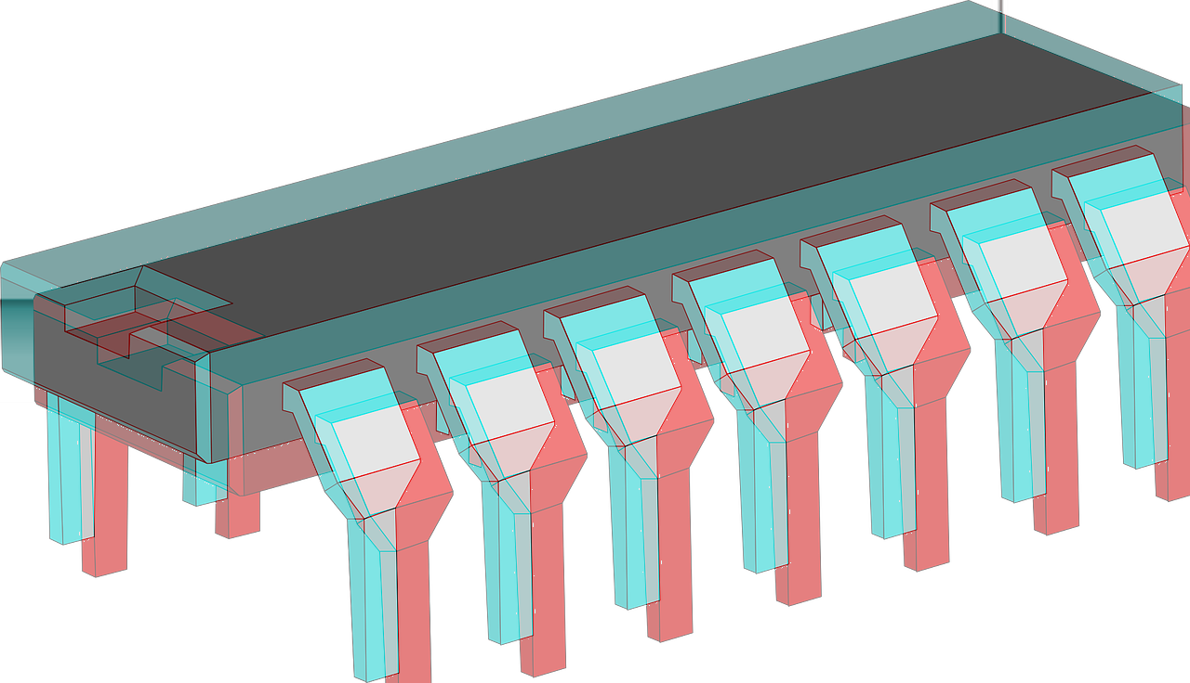
What is a 3D IC?

Slide 17
What is a 3D IC?
Face-to-Back (past)
Face-to-Face (present)
Transistor-on-transistor
(future)
Somebody needs to decide what goes where

Slide 18
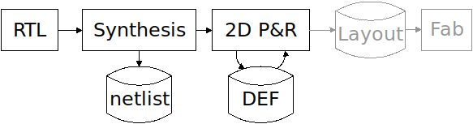
How do we design a 2D IC?

Slide 19
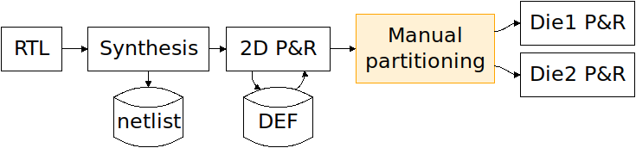
How do we design a 3D IC?

Slide 20
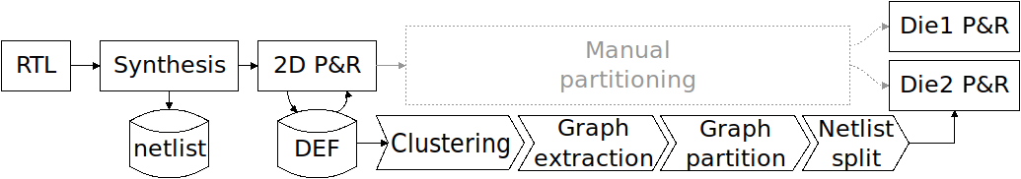
How can we do it better?

Slide 21
Two main challenges
Clustering
Grouping gates together
Partitioning
Splitting the design

Slide 22
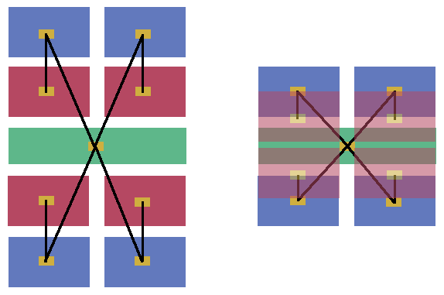
Why bother clustering?
The aim is to shorten the connections.

Slide 23
Why bother clustering?
The aim is to shorten the connections.
Can you see the risk in not clustering?

Slide 24
Why bother clustering?
The aim is to shorten the connections.
Can you see the risk in not clustering?
Do not cut short wires. Hide Them. Please.

Slide 25
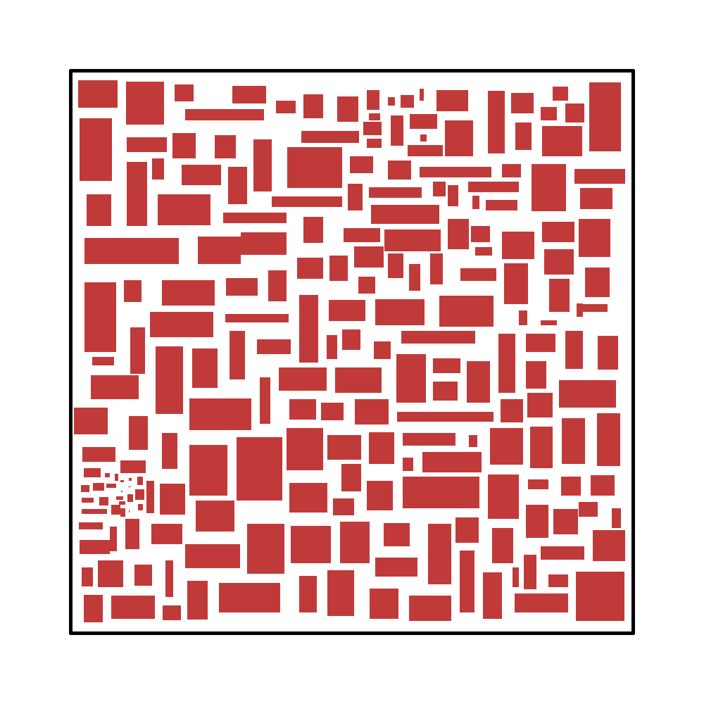
Clustering: Hierarchical geometric

Slide 26

Clustering: Hierarchical geometric

Slide 27
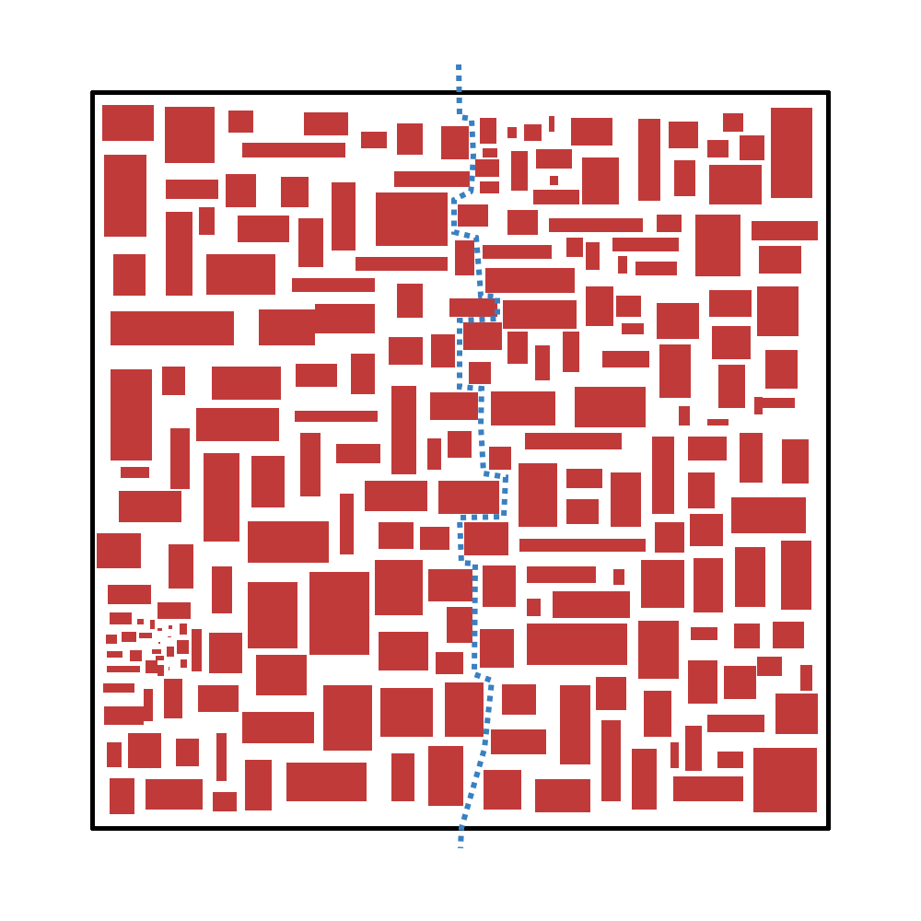
Clustering: Hierarchical geometric

Slide 28

Clustering: Hierarchical geometric

Slide 29
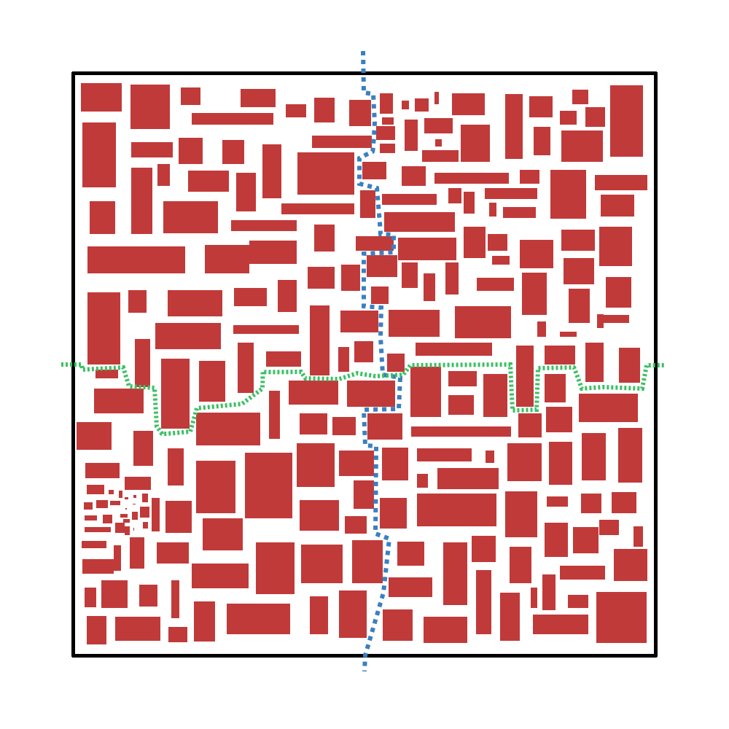
Clustering: Hierarchical geometric

Slide 30
Clustering: Progressive wire-length
Cluster the gates connected by very short wires
Check if the system is still “balanced bi-partitionable”
???
Forget about this method because it’s broken
→ Cluster phagocytosis

Slide 31
Partitioning: MIN-cut
Cut as few nets as possible
Minimize 3D connections

Slide 32
Partitioning: MAX-cut
Cut as many nets as possible
Maximize 3D connections (if you clustered cleverly!)

Slide 33
Let’s summarize all this
Traditional 2D ICs are in need of a paradigm shift.
3D is an alternative path to keep Moore going.
Clustering and partitioning are not trivial and matter.

Slide 34
What do you think?
Does it make sense to design 3D ICs based on 2D information?
Can you think of a nice way to cluster the design?
Do you have an opinion about IC manufacturing socio-ecological impact?

